Slide 1
Digital Learning Unlocked
Affordable Tools and Tech for Next-Gen APP Education
Diana Brewer, PA-C · September 2026 APP Fellowship Conference

Slide 2
Welcome & Framing
1
You don't need to be a technology expert, just a clinician who knows what your learners need.
Today we practice building small things, then spend real time building more things.

Slide 3
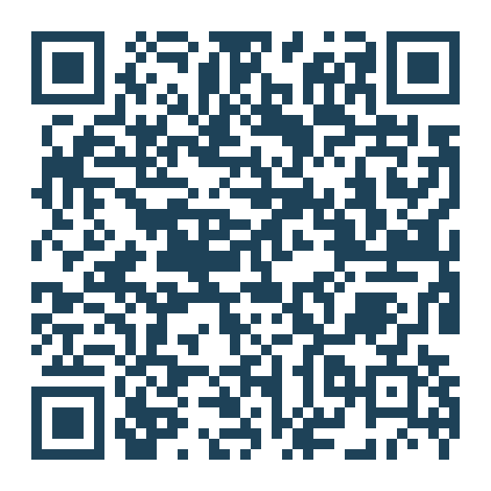
Conflict of Interest & Session Format
• COI: Diana Brewer is a co-founder of Sapient Clinician
• This session is vendor-neutral
• 60 min: three short demos you play along with, then a long build block
• Keep the Workshop Guide open: the tool tables in Section 2 are worth a scroll now
• Everything stays available after the conference, including every prompt
Scan for the Workshop Guide page

Slide 4
Great Cases Already Exist, Free
Where the material for everything we build today comes from · Guide → Section 2
THE SOURCE: MedEdPORTAL
WHY START HERE
The AAMC's peer-reviewed, free teaching-case library
Today's running example: a peritonsillar abscess case, six published files
Narrative, labs, EKG, CT, X-ray, and the faculty rubric: download from the Running Example, Section 2
Peer-reviewed, citable, expert-vetted: this is ground truth
You never start from a blank page
The same six files power every build today
De-identify your own material the same way
Guide → Section 2, Running Example (download the files)

Slide 5
Demo 1: AI Builds the Static Case (5 min)
Published files in, one shareable HTML file out · Guide → Section 2
THE BUILD
PLAY IT AS THE STUDENT
Upload the six case files, then paste Prompt 1 from Section 2
Out comes index.html: a complete branching scenario
No H5P, no code, no install: share one file by link, LMS, or email
Click through the finished case as a student
Type your reasoning at every decision
On the debrief screen, download your results file
That download is exactly what your instructor receives back
Static: built once, every learner gets the same published case

Slide 6
Demo 2: The Same Case, Live and Grounded (5 min)
You build this one: one paste, nothing to upload · Guide → Section 3
THE BUILD
PLAY, THEN SHARE IT
New chat, paste Prompt 2 from Section 3: the case file rides inside
The chatbot becomes the patient: first person, grounded
Ask for labs and you get the published values, never inventions
Run the encounter, then type encounter over
Full debrief: five domains, rated, with evidence
Run it once yourself, then share the chat link with students
Diana's shared conversation is open in Section 3
Dynamic: regenerated each time, and grounded in the source

Slide 7
Table Talk: Static or Dynamic? (2 min)
Two versions of the same case, two different jobs · Guide → Section 3
THE QUESTION
WHAT EACH DOES BEST
When would you reach for the static version?
And when does the dynamic version win?
Standardization, grading, replay, feedback: which one fits?
Static: the same path for every learner, easy to standardize
Dynamic: practice the encounter itself, feedback on the reasoning
Same case, same files, different teaching moments
Guide → Section 3, the table conversation

Slide 8
Demo 3: The Neat Things NotebookLM Does (7 min)
From grounding by hand to grounding as the product · Guide → Section 4
WHY IT'S DIFFERENT
THE AML NOTEBOOK
All session: the prompt plus the published files, grounding by hand
NotebookLM: upload sources once, grounding is the whole product
Every answer cites the source and section: checkable
Six published sources on a new leukemia drug, already uploaded
The audio overview is in your guide: press play
Five minutes: poke and prod, ask anything, try one creator
The build block is where you make your own

Slide 9
The Fidelity Spectrum
Match the tool to the goal, not the other way around
THE SPECTRUM, LEFT TO RIGHT
WHERE REASONING LIVES
• Text and audio, $0 to $20/mo
• Image-based, free to $25
• Screen-based, free trials
• AR on your phone, free to $25
• Immersive VR, $100 to $600
Text and audio, images included: ECG, X-ray, CT, labs.
The uncanny valley of avatar tools is real.
Some text-and-audio tools already do this well.
Workshop Guide → Sections 5 + 6 (VR: your take-home)

Slide 10
Think · Pair · Share: Match the Tool (2 min)
Pick a clinical skill your fellows need to learn.
Which point on the spectrum fits, and would the free option do the job?
Workshop Guide → Section 5

Slide 11
The Build Block: Make One Real Thing (24 min)
Your pick, your sources, our prompts · Guide → Section 7
PICK YOUR BUILD
HOW IT RUNS
Your own static case: Prompt 1, any published case
Your own dynamic case: Prompt 2, same files
Something from a notebook: the AML sources, or any topic
Teaching session, journal club, pre-brief: Prompts 3-8
The Prompt Builder worksheet assembles your prompt as you fill it in
Build with your table or solo, Diana circulates
At 0:52 we share a few cool things people made
Everything you build today goes home with you
Guide → Section 7, the Prompt Builder

Slide 12
Share-Out (4 min)
A few cool things people made: show us what you built.
What it is, how you would use it, and what you would still need to make it real Monday.
Workshop Guide → Section 7

Slide 13
Wrap-Up
Start with one tool, one need, one small experiment.
Everything from today is in the Workshop Guide: bookmark it now.
The Zero Dollar starter kit is in Section 8.
Workshop Guide → Section 8 (all resources)

Slide 14
Thank You
Diana Brewer, PA-C
Knight Cancer Institute Hem/Onc APP Fellowship Director, OHSU · Co-Founder & CMO, Sapient Clinician
brewerd@ohsu.edu
Scan for the Workshop Guide

